Slide 1
Games of long tailed Chicken in the arctic.
Irrationality and fruits of interdisciplinary research in decision theory.

Slide 2
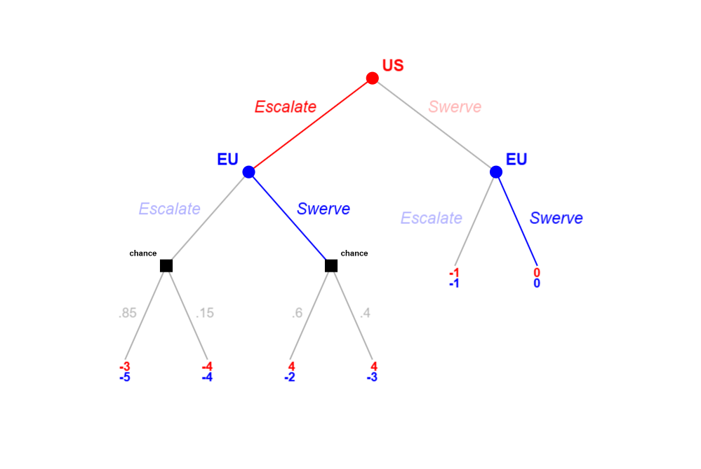
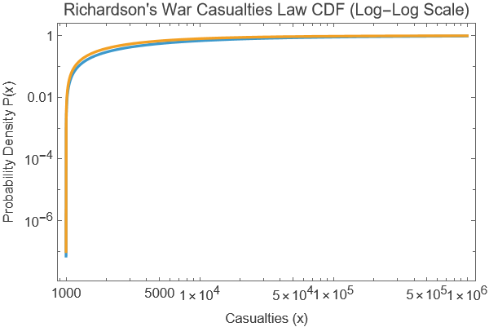
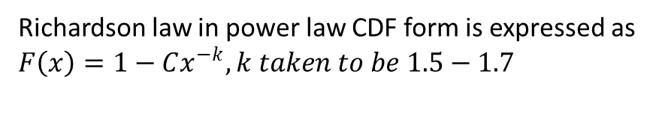
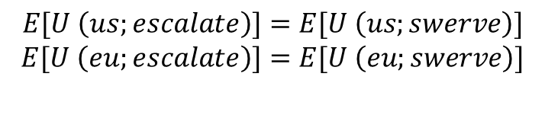
Sequential Games, Backward Induction and their limits under heavy tails . Chicken Game in Greenland.
$$E[U \left(us;escalate\right)]=E[U \left(us;swerve\right)]$$
$$E[U \left(eu;escalate\right)]=E[U \left(eu;swerve\right)]$$
Richardson law in power law CDF form is expressed as $F\left(x\right)=1−Cx^{−k}, k taken to be 1.5−1.7$

Slide 3
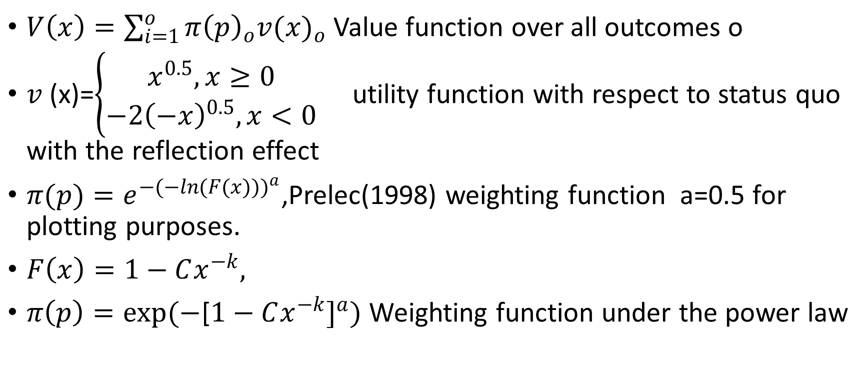
Where Normative Theory isn’t enough. The uneasy truce between Constructivism in IR and Prospect theory.
$V\left(x\right)=\sum_{i=1}^{o}{{π\left(p\right)}_{o}{v(x)}_{o}}$ Value function over all outcomes o
$v$ (x)=$\begin{matrix}\left\{\begin{aligned}x^{0.5},x≥0 \\ −2{\left(−x\right)}^{0.5},x<0\end{aligned}\right. & \end{matrix}$utility function with respect to status quo with the reflection effect
$π(p)=e^{{−(−ln(F(x)))}^{a}}$,Prelec(1998) weighting function a=0.5 for plotting purposes.
$F\left(x\right)=1−Cx^{−k},$
$π\left(p\right)=exp(−$[$1−Cx^{−k}]^{a})$ Weighting function under the power law

Slide 4
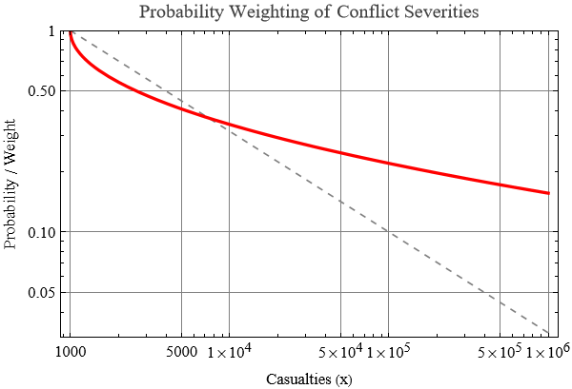
Probability Weighting effects under Richardson Law. Irrationality and game dynamics

Slide 5
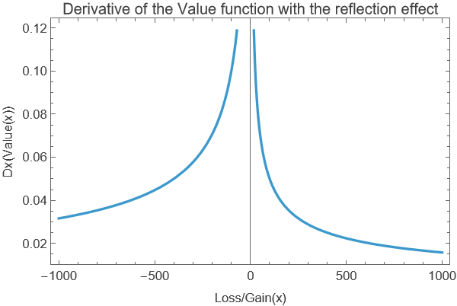
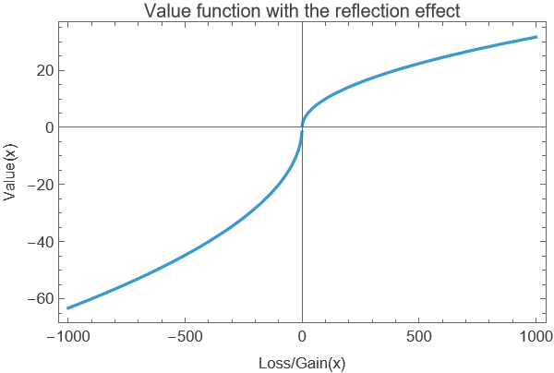
Framing and risk aversion. Choosing rational outcomes for irrational reasons. The Davos “Swerve”

Slide 6
Better theories better models. The fruits of interdisciplinary research in decision theory.

Slide 7
Extra.Strategic hysteresis? The Poisoned Chalice of the Iran Iraq war after Second Khorramshahr(1982).

